Slide 1
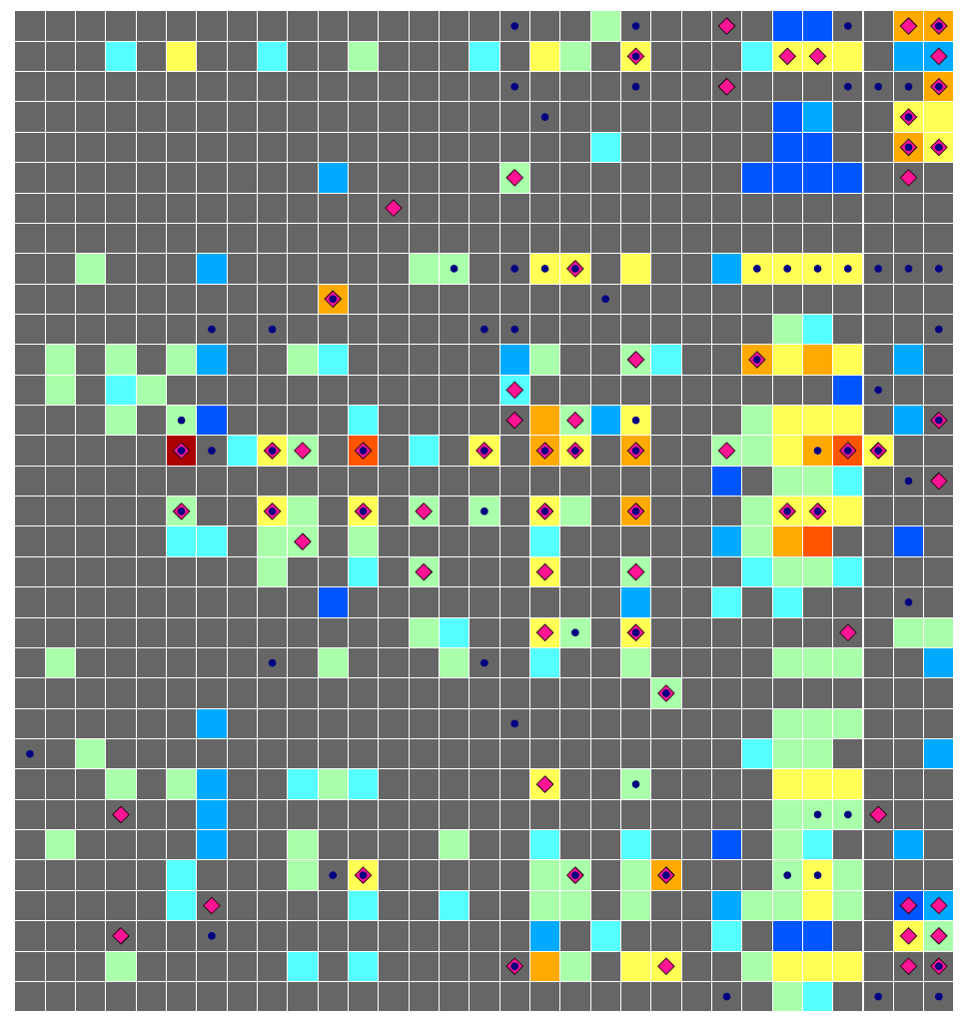
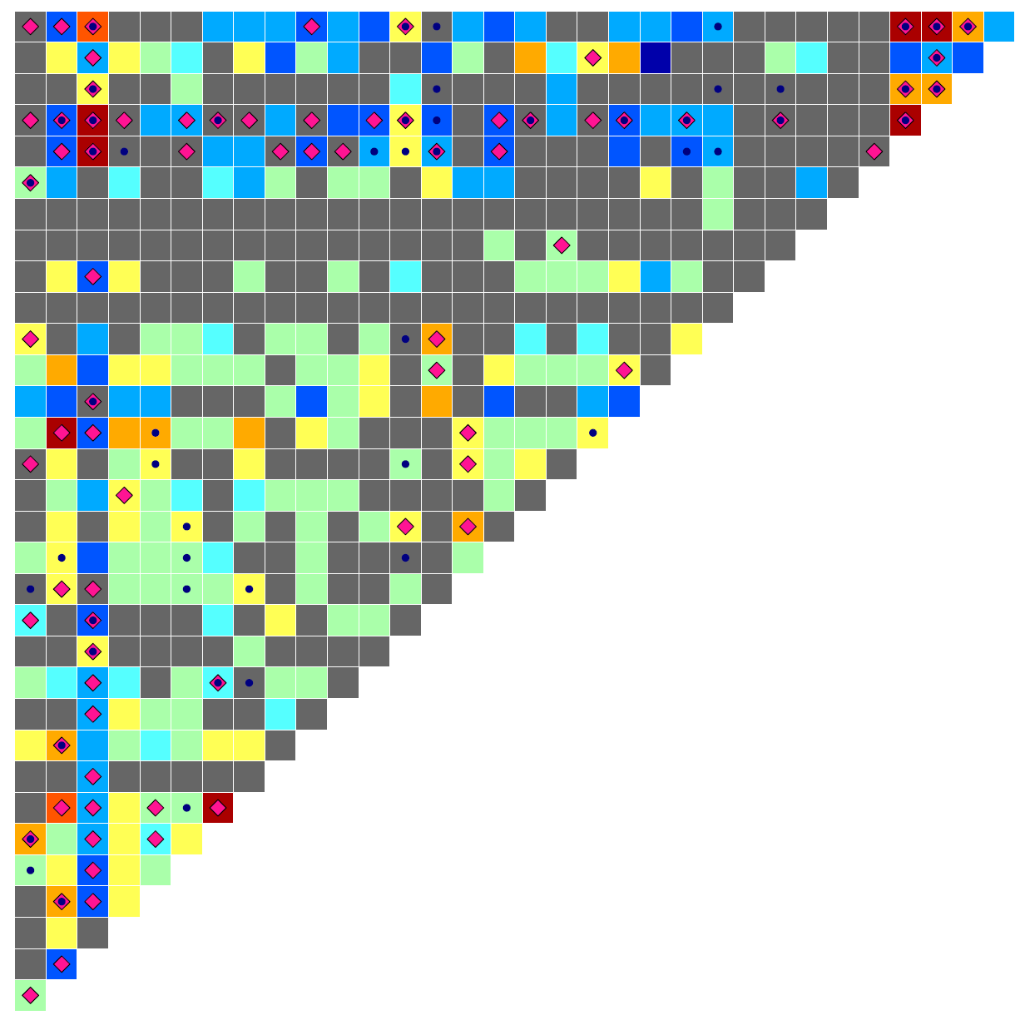
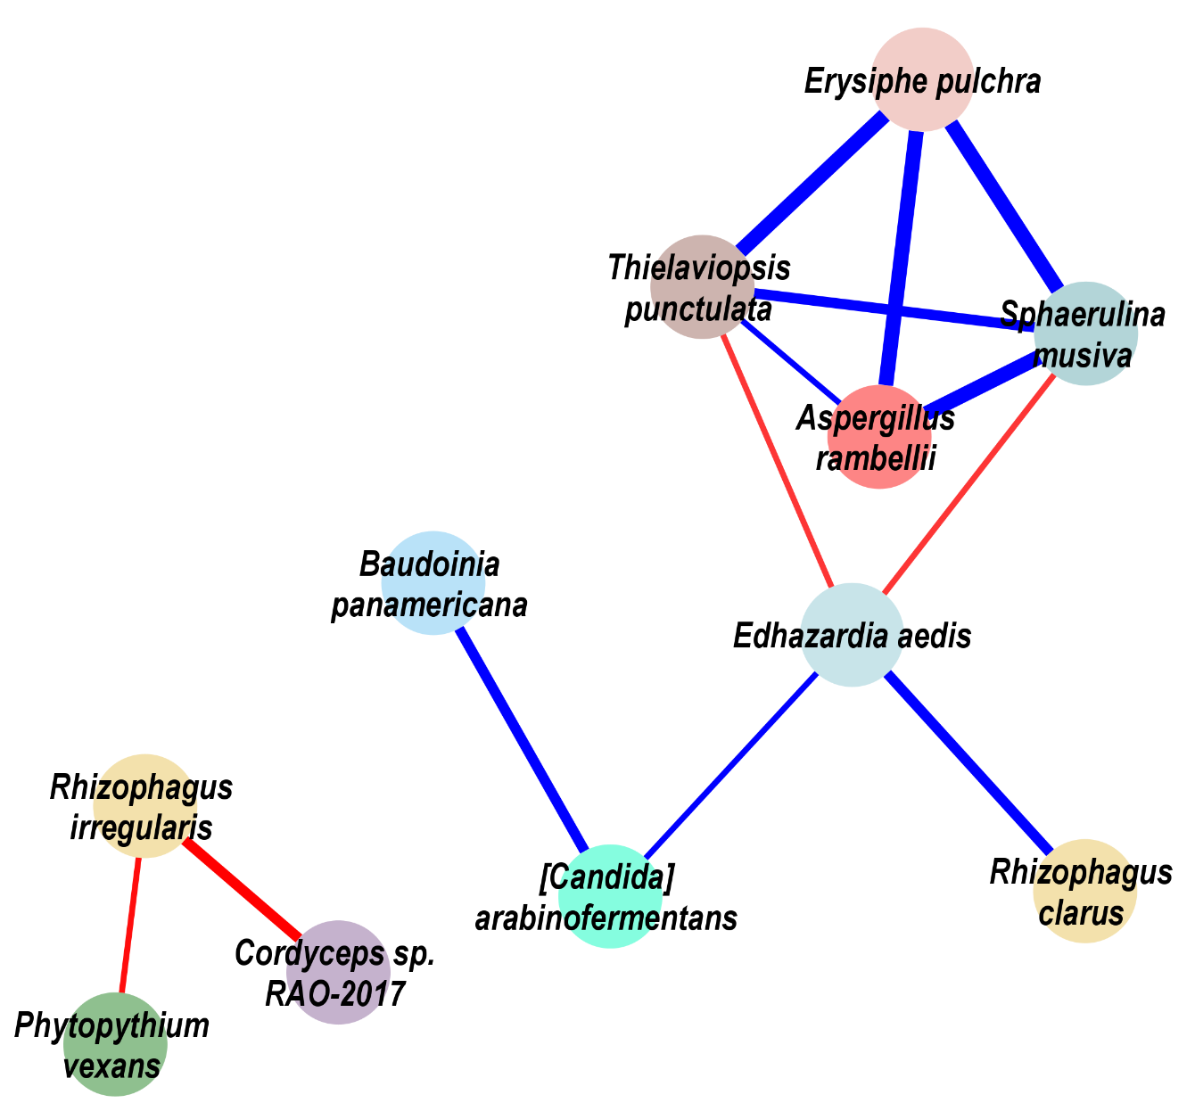
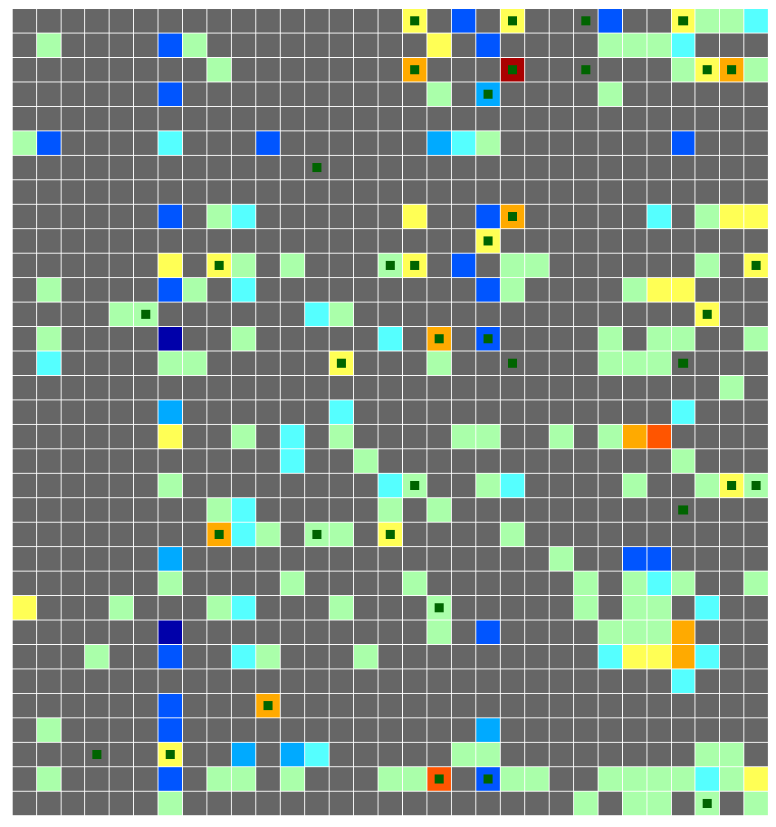
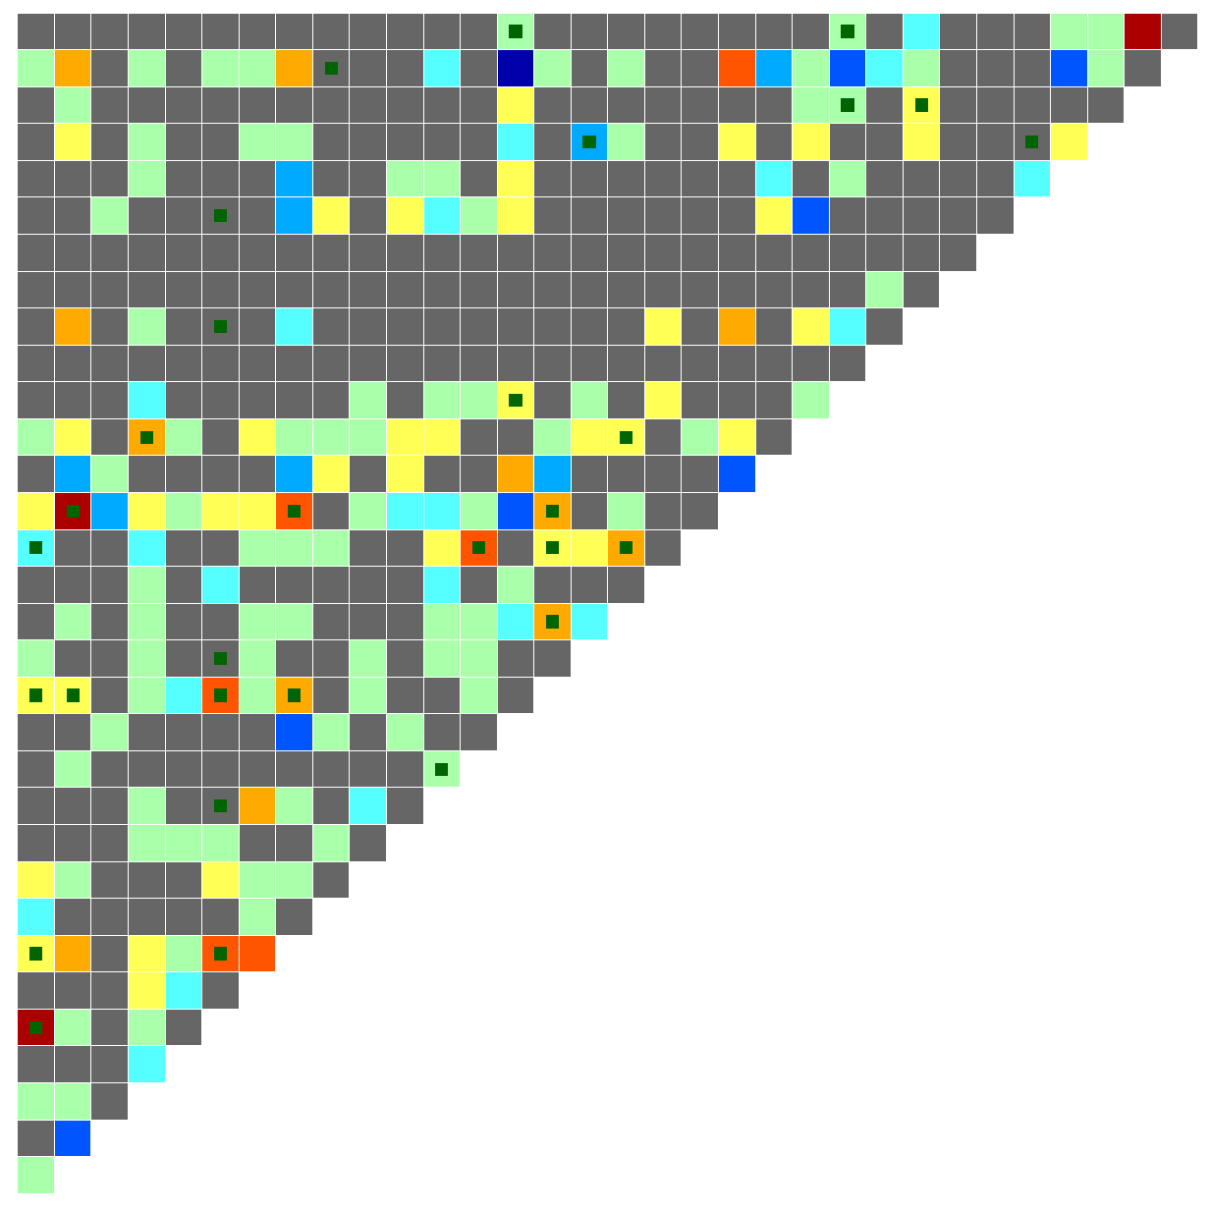
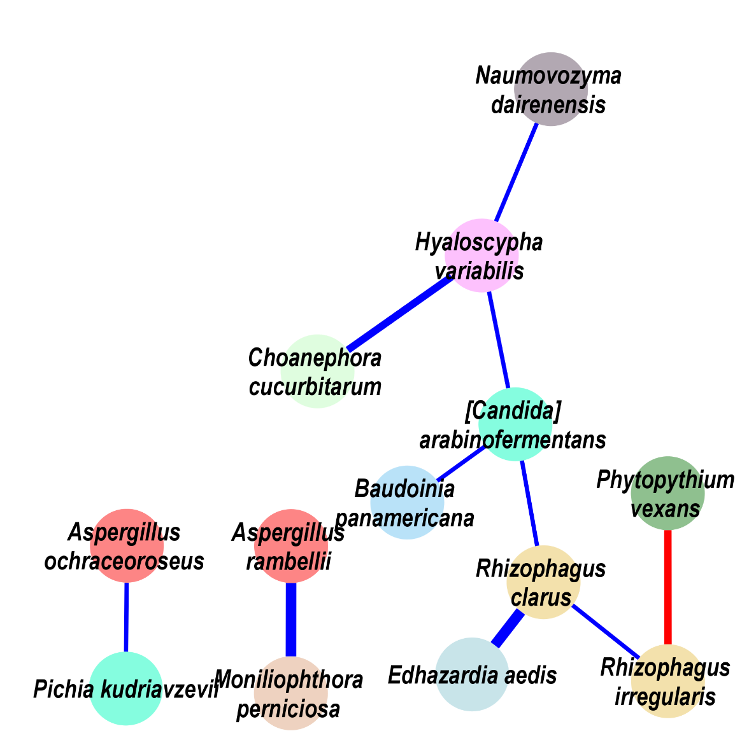
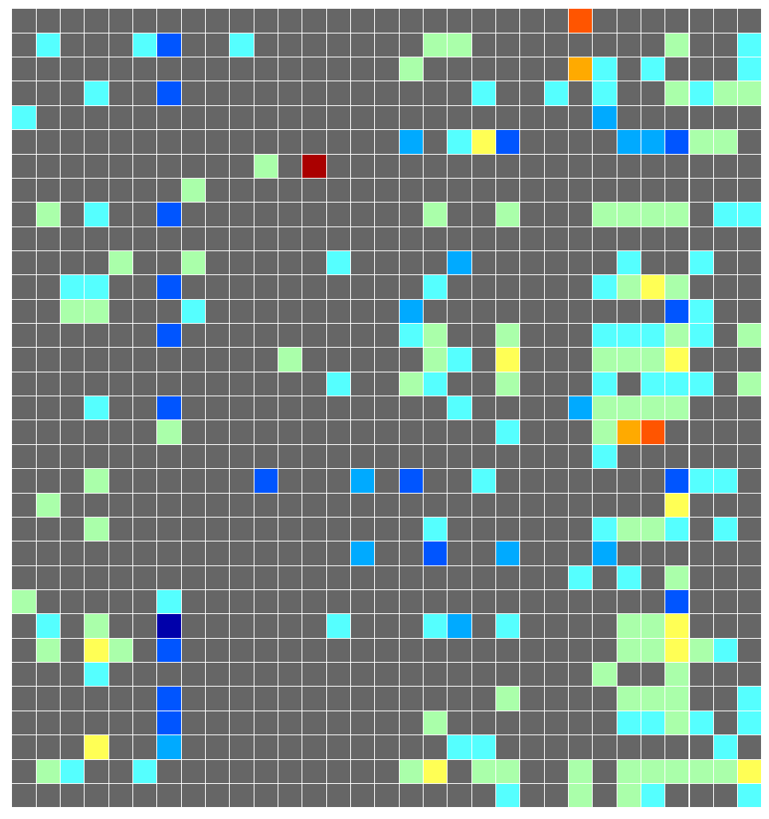
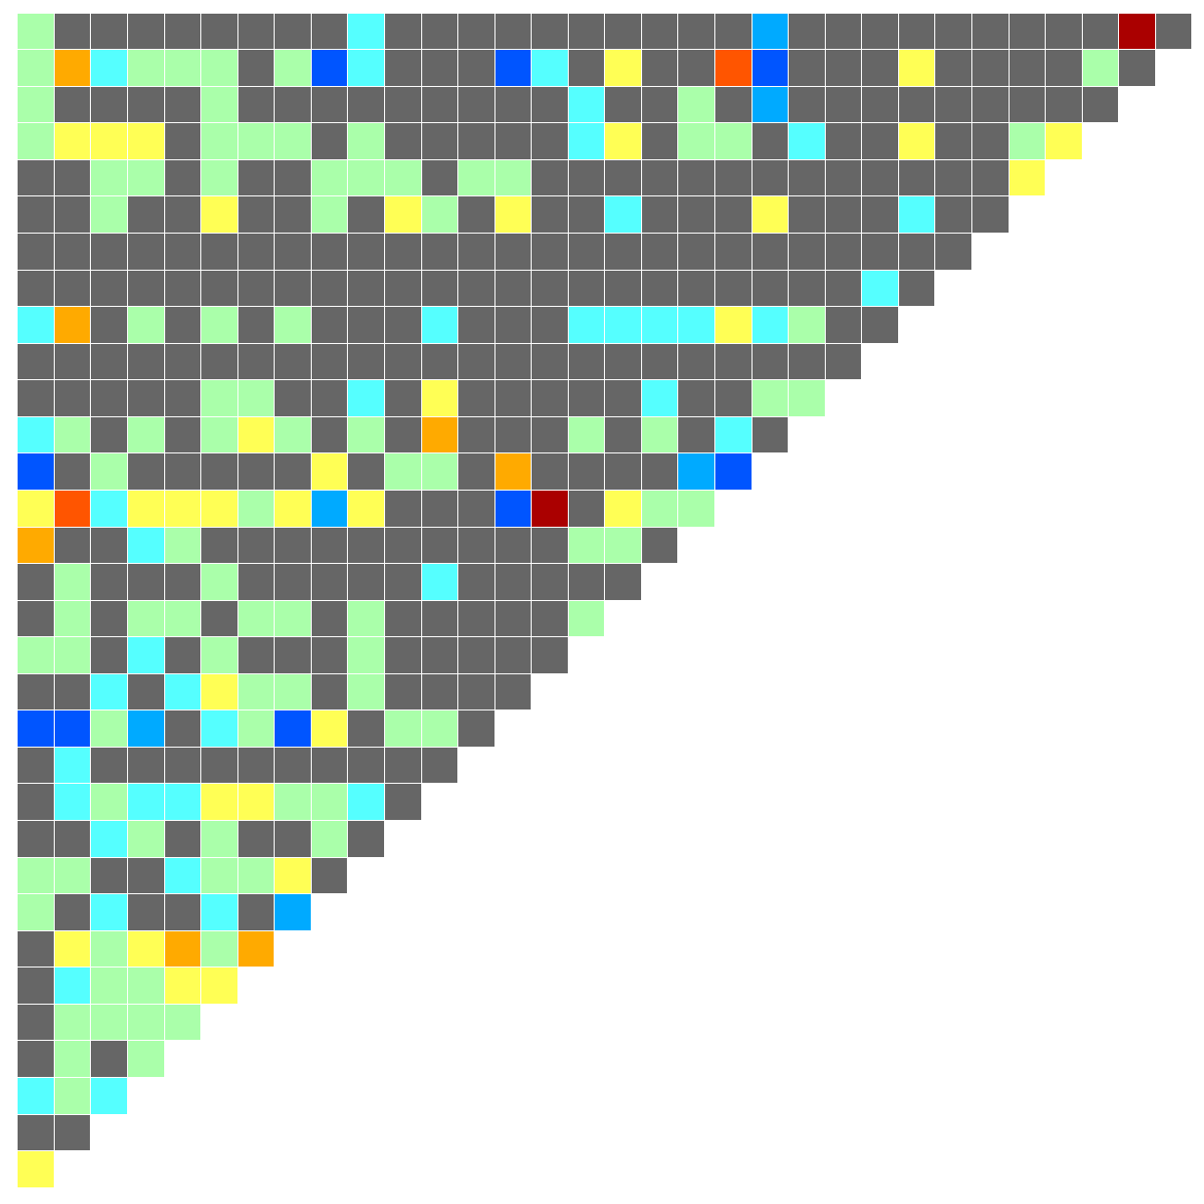
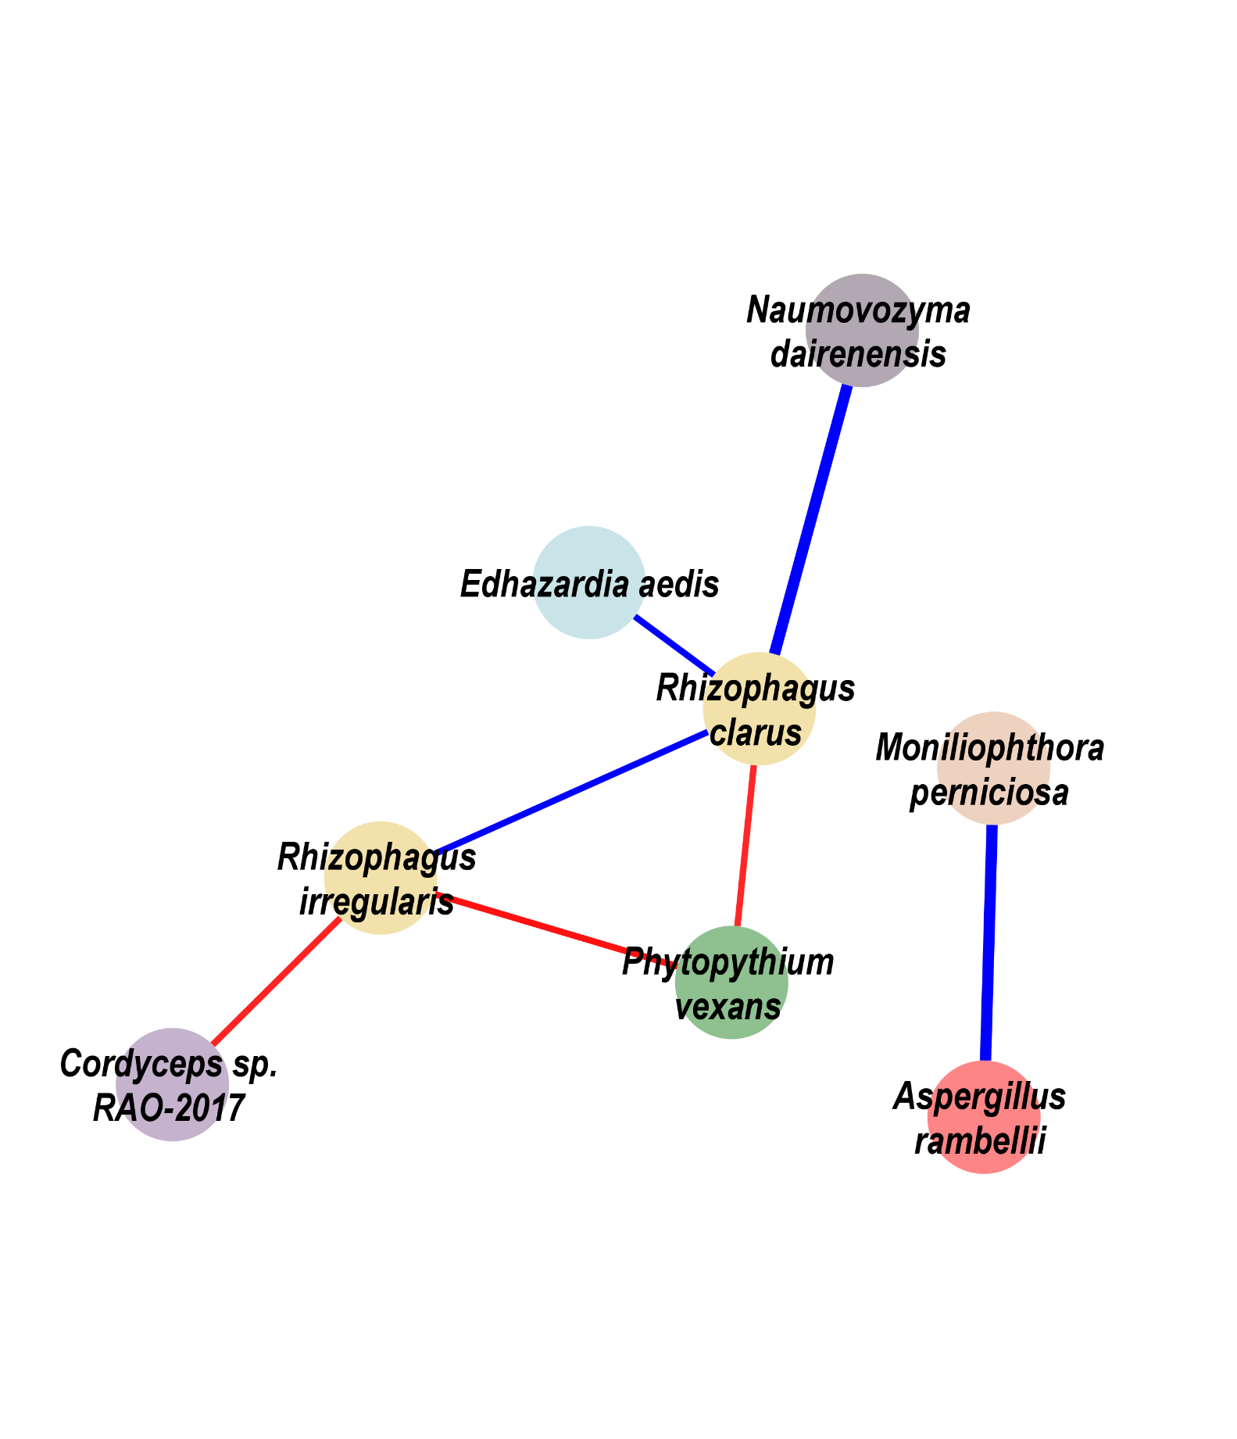
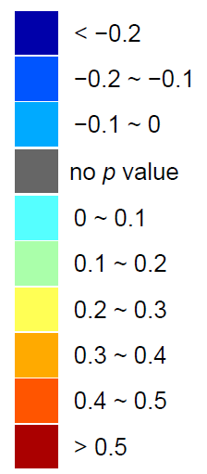
Figure 3
Escherichia coli | Bifidobacterium longum | Ruminococcus bicirculans | Adlercreutzia equolifaciens | Bifidobacterium adolescentis | Streptococcus thermophilus | Prevotella intermedia | Bifidobacterium bifidum | Streptococcus milleri | Streptococcus equinus | Bifidobacterium pseudocatenulatum | Streptococcus salivarius | Bifidobacterium angulatum | Lactobacillus ruminis | Bifidobacterium catenulatum | Streptococcus anginosus | Fusobacterium periodonticum | Clostridium beijerinckii | [Eubacterium] eligens | Porphyromonas asaccharolytica | Romboutsia ilealis | Brachyspira pilosicoli | Lactococcus garvieae | Dialister pneumosintes | Roseburia intestinalis | Butyrivibrio proteoclasticus | Pseudobutyrivibrio xylanivorans | Anaerostipes hadrus | Gemella morbillorum | Parvimonas micra | Fusobacterium nucleatum
Choanephora cucurbitarum | Edhazardia aedis | Thielaviopsis punctulata | Tuber magnatum | Schizosaccharomyces pombe | Hyaloscypha variabilis | Baudoinia panamericana | [Candida] arabinofermentans | Colletotrichum salicis | Leucoagaricus sp. SymC.cos | Coniochaeta ligniaria | Colletotrichum fioriniae | Aspergillus ochraceoroseus | Phytopythium vexans | Naumovozyma dairenensis | Lipomyces starkeyi | Albugo candida | Paracoccidioides brasiliensis | Pichia kudriavzevii | Rhizophagus clarus | Cordyceps sp. RAO−2017 | Pseudocercospora musae | Trichoderma atroviride | Debaryomyces hansenii | Pneumocystis murina | Aspergillus kawachii | Trichophyton mentagrophytes | Phytophthora capsici | Sphaerulina musiva | Erysiphe pulchra | Moniliophthora perniciosa | Rhizophagus irregularis | Aspergillus rambellii
Aspergillus rambellii
Rhizophagus irregularis
Moniliophthora perniciosa
Erysiphe pulchra
Sphaerulina musiva
Phytophthora capsici
Trichophyton mentagrophytes
Aspergillus kawachii
Pneumocystis murina
Debaryomyces hansenii
Trichoderma atroviride
Pseudocercospora musae
Cordyceps sp. RAO−2017
Rhizophagus clarus
Pichia kudriavzevii
Paracoccidioides brasiliensis
Albugo candida
Lipomyces starkeyi
Naumovozyma dairenensis
Phytopythium vexans
Aspergillus ochraceoroseus
Colletotrichum fioriniae
Coniochaeta ligniaria
Leucoagaricus sp. SymC.cos
Colletotrichum salicis
[Candida] arabinofermentans
Baudoinia panamericana
Hyaloscypha variabilis
Schizosaccharomyces pombe
Tuber magnatum
Thielaviopsis punctulata
Edhazardia aedis
Choanephora cucurbitarum
Bacteria
Fungi
CRC
Fungi
Aspergillus rambellii
Rhizophagus irregularis
Moniliophthora perniciosa
Erysiphe pulchra
Sphaerulina musiva
Phytophthora capsici
Trichophyton mentagrophytes
Aspergillus kawachii
Pneumocystis murina
Debaryomyces hansenii
Trichoderma atroviride
Pseudocercospora musae
Cordyceps sp. RAO−2017
Rhizophagus clarus
Pichia kudriavzevii
Paracoccidioides brasiliensis
Albugo candida
Lipomyces starkeyi
Naumovozyma dairenensis
Phytopythium vexans
Aspergillus ochraceoroseus
Colletotrichum fioriniae
Coniochaeta ligniaria
Leucoagaricus sp. SymC.cos
Colletotrichum salicis
[Candida] arabinofermentans
Baudoinia panamericana
Hyaloscypha variabilis
Schizosaccharomyces pombe
Tuber magnatum
Thielaviopsis punctulata
Edhazardia aedis
Choanephora cucurbitarum
Bacteria
Fungi
Adenoma
Fungi
Aspergillus rambellii
Rhizophagus irregularis
Moniliophthora perniciosa
Erysiphe pulchra
Sphaerulina musiva
Phytophthora capsici
Trichophyton mentagrophytes
Aspergillus kawachii
Pneumocystis murina
Debaryomyces hansenii
Trichoderma atroviride
Pseudocercospora musae
Cordyceps sp. RAO−2017
Rhizophagus clarus
Pichia kudriavzevii
Paracoccidioides brasiliensis
Albugo candida
Lipomyces starkeyi
Naumovozyma dairenensis
Phytopythium vexans
Aspergillus ochraceoroseus
Colletotrichum fioriniae
Coniochaeta ligniaria
Leucoagaricus sp. SymC.cos
Colletotrichum salicis
[Candida] arabinofermentans
Baudoinia panamericana
Hyaloscypha variabilis
Schizosaccharomyces pombe
Tuber magnatum
Thielaviopsis punctulata
Edhazardia aedis
Choanephora cucurbitarum
Bacteria
Fungi
Healthy control
Fungi
Bacteria
Reported pathogens
Asperillaceae
Ceratocystidaceae
Choanephoraceae
Bacteria
Reported probiotic
Erysiphaceae
Glomeraceae
Hyaloscyphaceae
Fungus
CRC Enriched Fungus
Pichiaceae
Pythiaceae
Saccharomycetaceae
Fungus
CRC Depleted Fungus
Culicosporidae
Mycosphaerallaceae
Cordycipitaceae
Marasmiaceae
Teratosphaeriaceae

